Slide 1

THE USE OF STATISTICS AND DATA MINING TO INCREASE AUDIT EFFICIENCIES AND EFFECTIVENESS
Abraham Meidan, Ph.D.
WizSoft Inc.

Slide 2
The problem
How can statistics and data mining help us finding suspected cases of error or fraud in the data?

Slide 3
Answers
Outliers
Benford’s law
Data-mining
Text-mining

Slide 4
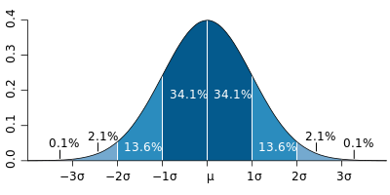
Outliers

Slide 5
Outliers
An example of outliers: cases that are 3 standard deviations from the average.
Outliers can be the result of random distribution.
If all the cases fall under a normal distribution, the outliers are probably not fraudulent cases.

Slide 6
Benford's Law
The law determines the expected frequency of each of the digits in numbers that refer to bills, street addresses, stock prices, death rates, population numbers, lengths of rivers, etc.

Slide 7
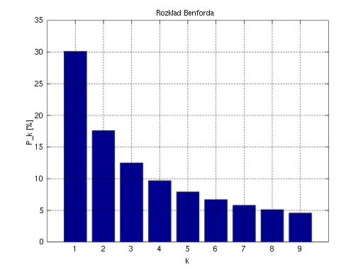
Benford's Law
The distribution of first digits

Slide 8
Benford's Law
The law does not hold in the following cases:
Account numbers, check numbers, invoice numbers, etc.
Prices such as $9.99

Slide 9
Benford's Law
Benford's law is relevant for revealing cases where all or most of the records are fraudulent.
Benford’s law is not relevant when only few records are cases of fraud.

Slide 10
Data Mining
Data mining programs reveal interesting and valid patterns in the data (patterns that cannot be revealed by standard SQL reports).

Slide 11
Data Mining
Data mining is used for issuing predictions
Example: the data mining algorithm reveals the patterns of customers that did not pay their debts on time, and these patterns are then used to predict the probability that a certain new customer will not pay his debt on time.

Slide 12
Data Mining vs. BI & OLAP
BI – Business Intelligence
OLAP – Online Analytical Processing
The contents of BI/OLAP reports are identical to the contents of Excel Pivot Table. (The difference relates to the speed of issuing the reports).

Slide 13
Data Mining for Auditing
On top of issuing predictions the data mining technology can be used for revealing suspected errors and frauds.
A deviation from a valid rule is suspected as error or fraud.

Slide 14
Data Mining for Auditing
Many errors and frauds are deviations from rules.
But not every deviation from a valid rule is a fraud or an error.

Slide 15
Data Mining Algorithms
Some data-mining algorithms:
Regression
Artificial neural networks
Decision tree
Association rule (if-then rules)

Slide 16
If-Then Rules
If the customer is company A, and the item is B, Then the discount is 15%
Rule probability: 99.9%
Number of cases: 1000
Significance level: error probability < 0.001

Slide 17
If-Then Rules
The significance level denotes the probability that the event presented by the rule is incidental (assuming there are no such rules in the population).
It measures the rule validity.

Slide 18
Deviations from If-Then Rules
Example:
If there is one sale transactions that –
meets the above-mentioned rule conditions,
but the discount is 25% (instead of the expected 15%),
then such a deviation should be suspected as an error or fraud.

Slide 19
Misses vs. False Alarms
 | The case deviates from a rule | The case does not deviate from a rule
The case is an error or fraud | OK | Miss (first type error)
The case is not an error or fraud | False alarm (second type error) | OK

Slide 20
Misses vs. False Alarms
There is a tradeoff between misses and false alarms - to reduce misses and raise false alarm:
Reduce the minimum number of cases in a rule
Reduce the minimum probability of a rule

Slide 21
Non-Material Cases
To avoid dealing with non-material transactions, one can filter the suspected transactions, for example by the amount.

Slide 22
Deviations from Mathematical Formulas Rules
Example:
Total = Quantity x Unit Price x (1 - %D/100)
Any deviation from such a formula is either a software bug or a fraud, unless the difference can be explained as rounding.

Slide 23
Deviation of Rules from Meta-Rules
Example:
For all the customer the rule is:
If the customer is company X, and the item is B, then the discount is 10%
The rule that relates to company A is:
If the customer is company A, and the item is B, then the discount is 15%

Slide 24
Criteria for Completing the Audit
Budget or time
The frequency of false alarms is higher than K%

Slide 25
Auditing Textual Data
If - (1) The textual value A is frequent, and (2) The textual value B is both, infrequent and very similar to A,
Then B might be an error or a fraud

Slide 26
Auditing Textual Data
Definition of text similarity:
The characters are identical except for one, which is missing, inserted or overwritten (e.g. Cambridge versus Kambridge or Cabridige or Camnbridge); or
The characters are identical except for two misplaced adjacent consonants (e.g. Cambridge and Camrbidge)

Slide 27
Text Mining
The previous slides referred to structured data (tables of records and fields).
Example of unstructured data: Word documents, e-mail messages, etc.

Slide 28
Auditing Unstructured Textual Data
Reveal the names or keywords
Save the names or keywords in a database
Run a data mining program to reveal connections between names or keywords

Slide 29
Auditing Unstructured Textual Data
Doc # | Name1 | Name2 | Name3 | Keyword1 | Keyword2
101 | 1 | 0 | 1 | 0 | 1
102 | 1 | 0 | 1 | 1 | 0
103 | 0 | 1 | 0 | 0 | 0
104 | 1 | 0 | 1 | 1 | 0
105 | 0 | 1 | 0 | 0 | 1
106 | 1 | 0 | 1 | 1 | 1

Slide 30
Questions

